Slide 1
2024
Chetnole Parish Plan
Survey Results & Recommended Actions

Slide 2
Nice Place, Nice People.
“
”
Young Resident of Chetnole & Stockwood October 2023

Slide 3
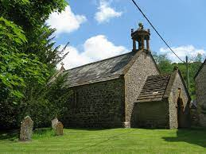
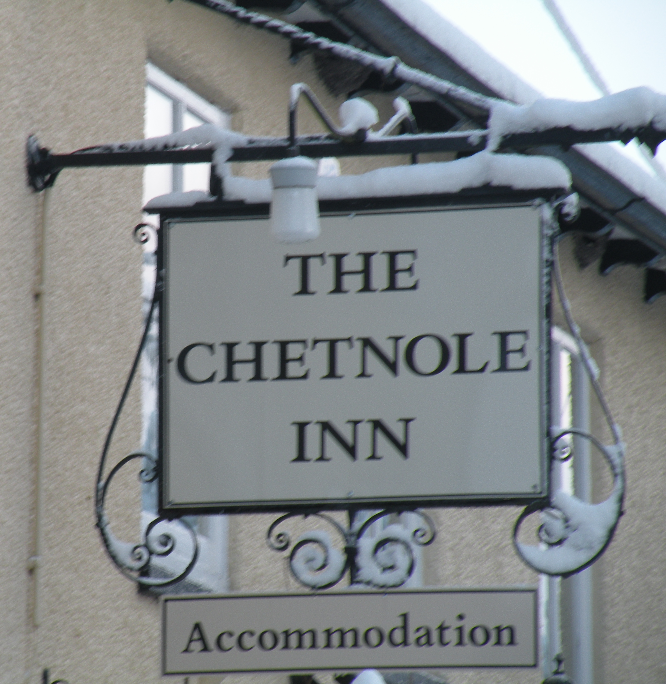
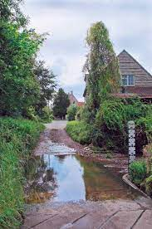
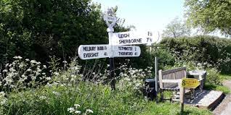
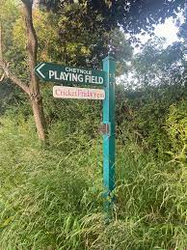
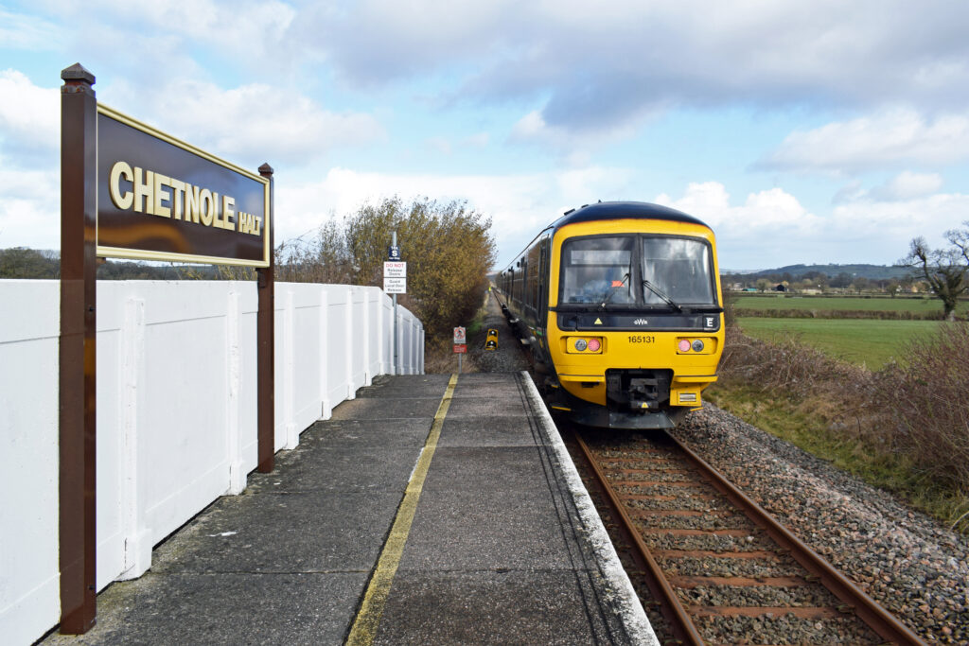
Contents
Parish Plan Goals
Survey & Process
Findings
Recommended Actions

Slide 4
Parish Plan Goals
Relevance & Engagement: A parish plan is a living, breathing document and should be revisited on a cyclical basis to ensure relevant outcomes & community engagement.
Update Views: New residents with different requirements and levels of willingness to help. New Societal changes: climate change, sewage, cost of living
Create Accountability: Maintain focus for volunteer groups or GVMT organisations.

Slide 5
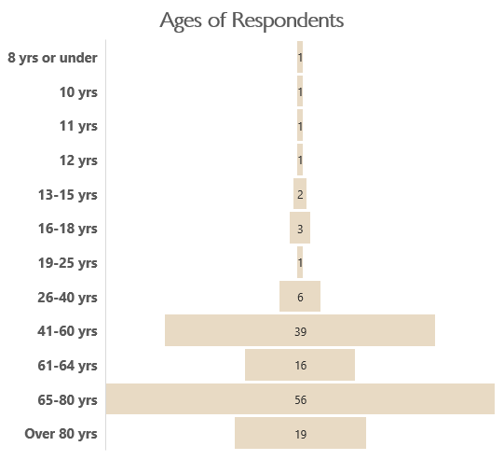
The Survey
We had a Response Rate of 201 or a little over 53% of the population of 380 in Chetnole & Stockwood. In 2010 we also had 53% but of households only.
Based on those who entered post codes, we had 2 responses from Stockwood and 16 responses from Hamlet.
Paper copies distributed to every household in Oct 23 – only 21 received back.
3 sections: Children’s section for those under 13yrs (4 respondents); Main questionnaire for all residents. General questionnaire for one household member.
Data analysed had personal info removed
NB 58 respondents did not put their ages.

Slide 6
Survey Findings

Slide 7

What Three Words Best Describe Our Parish

Slide 8
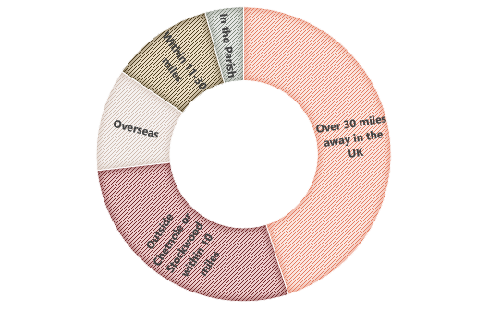
Living in the Parish
Where did you come from:
Tenure in the Parish:
Reasons for being in the Parish:
Some interesting reasons given for being in the Parish:
Opportunity to design and build our own house
Husband lived here as a child and his mother highly recommended the village
Return to childhood village
Three people born here

Slide 9
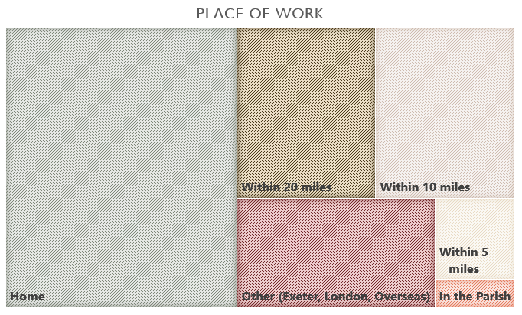
Occupations
Of 59 respondents working only 10 work beyond 20 miles away and 1 works within the parish.
Home is the principle place of work suggesting broadband important.

Slide 10
Respondent’s Households
93% of homes are Owner Occupied.
Significant majority of houses have more bedrooms than residents (bear in mind that couples will invariably share a room) There are 52 houses with 2 or more bedrooms than there are residents and 2 houses where bedrooms are shared (beyond couples).
There are only 3 multigenerational houses (grandparent, parents, children) and one house with 8 people over the age of 80 (mistake we think!)
1960 to 2000 saw a boom in house building in the Parish, with more homes built than all those since 1600’s however only 3 houses built since 2000.
This information generally reflects the findings of the 2021 Census Which you can access here: https://www.ons.gov.uk/

Slide 11
Community & Communication
The most high profile organisations are the Parish Council, Village Hall Committee & the Cricket Club. A third of respondents know how to contact the Church Warden; Flood Warden & Neighbourhood Watch Rep. Less than 20% of people know how to contact the Local Policing Force.
Of 10 methods to find out what’s happening, the top three are: Wriggle Valley Magazine; Weekly Village Diary; Word of Mouth. The least used methods are: The Parish Council Website & Welcome Leaflet. Social media came 5th & 6th (WhatsApp & Facebook).
There are implications for road traffic volume as a third of shopping done online particularly clothing, books & entertainment, home goods. Sherborne favoured for Food, Drink and Medical goods. Yeovil favoured for DIY & Electrical Goods. Shopping is the principle use of the internet for respondents (over 50%) followed by Google search & emailing.
Notes:
ACTION: Update contact info for local wardens & bodies on PC website – circulate. Ask representatives to publish news/updates
Formalise the Weekly Village Diary for GDPR and train one other person to manage it.

Slide 12
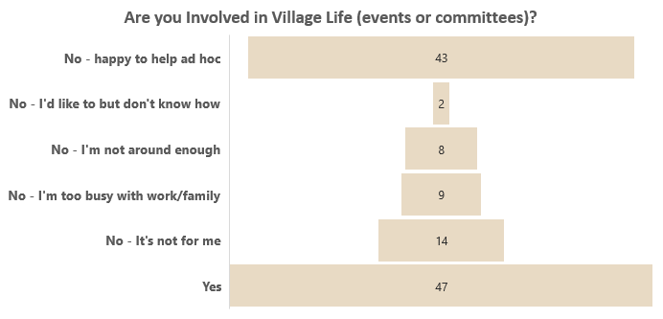
Community Involvement & Ideas
Many respondents are involved in Village Life…. however less engaged residents are less likely to answer this questionnaire.
Would like to see more:
Other suggestions:
A shop
Arts & Crafts Group
Travelling Fish/bread sales van
Croquet & tennis
Film nights
Reading Group
Dance evenings e.g. country dancing
Village Cider!
Notes:
ACTION:
Working Group to implement 2 – 3 new village events in 2024.
Comms channels to Update info about local clubs & circulate

Slide 13
Transport & Traffic
Unsurprisingly 121 respondents use a car as their primary form of transport of which 13 are hybrid/EV
Traffic speed and volume are a concern with the most popular speed control measures being speed activated signs; clearer existing signs and warning signs. Only 16% of respondents want a reduction in speed limit. Six respondents feel that we should make no change. Key danger spots are: Road leading to Stockwood (also from 2010 survey); the Stockwood/Chetnole T junction and Dunch Lane.
The majority of people state they would rarely if ever use a bus service, however 8 people requested one in the final comments section. No one seems to struggle with getting to after school activities
Chetnole Halt access is used primarily for social or leisure purposes with seven respondents using it “often” for work or shopping. Most popular stations are Bath, Weymouth, Dorchester & Bristol
Notes:
ACTIONS: Set up speed mgmt. team; add mirrors to danger spots; push campaign for action on step free access & parking at Chetnole Halt with GWR & NWR

Slide 14
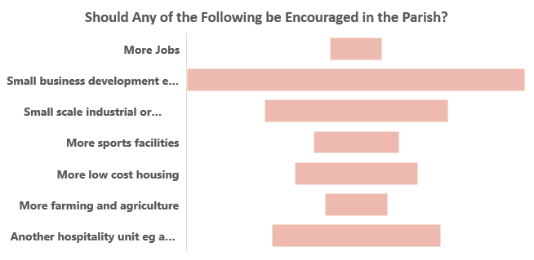
Village Environment
90 Respondents would like to see a small business development such as a shop. This is a recurring theme throughout the comments.
71 respondents would like a footpath to Chetnole Halt and 38 would like cycle path links to other villages. Over 2/3rds of respondents think the footpaths are well maintained, although there were several concerns about the state of stiles and absence of clear signs.
The majority of respondents are satisfied with the number of litter and dog waste bins
In order of priority the most important things people want to do for our roads & byways is improve ditch maintenance (almost half of respondents), remove litter & manage the verges for wildlife.
Managing hedges for wildlife, cleaning the river and planting more trees are the top concerns for the village environment. Electric charging points and planting more hedges are the least important.
Notes:
ACTION: Footpath warden to map broken stiles & signage issues.
Small business/shop working group

Slide 15
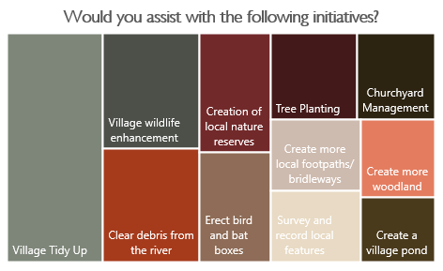
Sustainability & Natural Environment
Flooding is a key issue perhaps as we had extraordinary flooding at the end of Oct’23 Over 63% of respondents feel our flood warning scheme is adequate. 46 respondents have experienced flooding on/in their property. 20 respondents say they have erected flood defences with help from the environment agency.
Notes:
ACTION:
Research bulk discounts and grants for energy efficiency measures
Biodiversity working group to coordinate village tidy up, clearing river, wildlife hedgerows and planting.
Update and support from WRIG on flood management & environment agency.

Slide 16
Views on Services in the Parish
The Dr’s surgery and Refuse Collection are best performing local services with the majority of respondents rating them good. The Postal Service and telephone reception rated good or reasonable by most respondents.
Opinions split on quality of service for Mobile Phone Service, Road maintenance and cleaning. The first maybe addressed through the provider. Broadband service generally considered good or reasonable but a third of respondents experience poor service.
Health services are not used by many but those that use them feel there is room for improvement with ambulances
Notes:
ACTION: escalate concerns about road maintenance & ditch management to Dorset Council Highways
Investigate new broadband solutions

Slide 17
Local Services & Facilities
Dog walking, the play equipment and the picnic area are the most popular uses for the playing fields – suggestions for the playing fields included: better play equipment; gym equipment; a tennis or padel court or croquet. Otherwise people were agreed that the playing fields should be left undeveloped.
Notes:
ACTION: Working Group of volunteers to assess feasibility of a shop. Review of playing field equipment & facilities.

Slide 18
Policing & Security
The majority of respondents feel there is adequate police presence and feel safe walking in the village after dark. Although there are a couple of comments about the need for more visibility of the police.
Fortunately, we suffer from low crime with only 12 people experiencing excessive noise and 6 having had a theft from an outbuilding.
Notes:
ACTION: An enhanced neighbourhood watch scheme should be investigated with input from the local police.

Slide 19
Local Government Planning & Development
Over half of respondents know who their Parish Councillors are and felt well informed of their activities. Otherwise they felt the Parish Council are aware of local concerns but this diminishes further up the scale of government bodies (District Council; Dorset Council; MP) which is to be expected.
Planning applications are well communicated (66% of respondents) but housing development is an emotive issue.
Over 70% support the development of a Neighbourhood Plan but almost the same proportion would not want to be involved.
Some people are keen to see new housing but six respondents would prefer no development at all. Those that support it want any development to serve the local population and needs.
Notes:
ACTION: Working Group to assess feasibility & use of a Neighbourhood Plan with a focus on affordable housing for local people and renovation of existing stock.

Slide 20
Children’s Section
Open to those under 13years and a very low response rate of 4, however there was a lot of positivity with them describing the Parish as Fun (things to do), Friendly, Graceful, Happy, Safe, Cosy, Green, Lovely, Amazing, and they would highly recommend the Parish to friends as somewhere to live and think it is a good place to grow up.
They are reliant on their parents to get about, with one person using the school bus and their bicycle. No one uses the train because it doesn’t serve the destinations they need.
Generally they participate in sports or music activities with one person also doing music and country pursuits. They would like to see a Youth club, Sports club (football & cricket), Film shows in the village hall and summer holiday activities.
They are avid users of the football pitch, basketball court, play equipment but would like to see repairs to the nets and some more play facilities such as a zip wire or bike park
Albeit a small response group, it is good to hear their voices.
Notes:
ACTION: Update Play Equipment; investigate possible activities for younger generation such as Summer or Youth Club.

Slide 21
Comments
There were a host of suggestions and views in the comments section which we have tried to group into themes:

Slide 22
Recommended Actions

Slide 23
Recommended Actions
We have provided a list of principle recommended actions. There are smaller ones you may want to take up with a group of fellow residents.
Actions are more likely to happen if driven by a broad group of Parishioners and allows new faces to get involved.
Some actions fall within the remit of existing village bodies or the Parish Council.
Some require volunteers….
These actions have been divided into short, medium and long term actions.

Slide 24
Events
Who:
Requires a group of volunteers
Establish & deliver 2-3 new events around arts / youth / sports with potential for a regular Summer club for younger generation.
Community
M
Communication
Who:
A parish councillor; WVM Rep; Ediary administrator.
Build on principle communication channels: PC Website & E-Diary with up to date information about clubs, committees and local information
S
Small Businesses
Who:
Requires a group of volunteers
Team to assess feasibility & practicality of a shop or alternative small businesses operating in the Parish. Create proposal for the Parish.
L
Building Development
Short Term c.6 months
Medium Term 6 – 18 months
Long Term 18 months – 3 year
Who:
Requires a group of volunteers
S
M
A group to undertake a Neighbourhood Plan addressing what the Parish wants in terms of preservation & future development i.e. affordable housing & style of development & green spaces
L
L

Slide 25
Road Safety
Who:
Speed watch volunteers.
Transport
M
Establish Traffic Speed Management team to reduce speed of traffic through village and address danger points with mirrors
Chetnole Halt
Who:
Friends of Chetnole Halt.
L
Secure Step-free Access & Car Parking at Chetnole Halt
Flooding Danger Spots
Who:
Flood
Warden & WRIG (Wriggle Valley Improvemenjt Group).
Implement traffic barriers at Deep Ford Lane to prevent through traffic during flooding
Short Term c.6 months
Medium Term 6 – 18 months
Long Term 18 months – 3 year
M
S
M
L

Slide 26
Biodiversity & Sustainability
Who:
Requires a group of volunteers
L
Research & secure a community scheme with providers of renewables & home energy efficiency measures to enable residents to reduce their carbon footprints
Identify & Action methods to improve Biodiversity i.e. Hedgerows Management & Tree Planting
Environment
Who:
Requires a group of volunteers
M
Village Environment
Who:
Requires Volunteers
S
Litter Picking Team to carry out periodic litter picks
Footpath clearance & signposting, and reporting of issues to Dorset Council
Who:
Footpath Warden
S
Flood Management
L
Implement methods to reduce river and surface water flooding in the Parish
Implement methods to monitor & improve water cleanliness of River Wriggle.
Who:
WRIG (Wriggle Valley Improvemenjt Group).
Short Term c.6 months
Medium Term 6 – 18 months
Long Term 18 months – 3 year
S
M
L
M

Slide 27
Road Maintenance
Who:
Parish Councillor
S
Establish team to monitor and escalate road maintenance and ditch management issues to PC and Dorset Council.
Services
Broadband Connectivity
Who:
Footpath Warden
Research & propose alternative broadband providers to improve connectivity and performance.
L
Playing Field Facilities
Create a plan of phased, funded improvements to the play equipment reflecting requests from Parish Plan
Who:
Playing Field Mgmt Committee
M
Security
Who:
Neighbourhood Watch Coordinator
Short Term c.6 months
Medium Term 6 – 18 months
Long Term 18 months – 3 year
Deliver an enhanced Neighbourhood Watch Scheme to address communication and local policing involvement
S
S
M
L

Slide 28
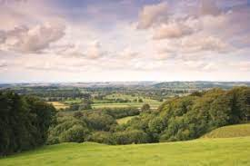
Making the Plan Happen.
Please consider actively helping to build on the work previous residents have done to make this a great place to live, by volunteering to be part of one of the working groups by contacting:
chetnolevillage@gmail.com
OR The Parish Plan Team
  Geoff de Metz – the Old Parsonage
  Michele Aldhouse – Four Martins
  Naomi Hewitt – Chetnole House

